Slide 1
A summary of
AN OVERVIEW OF MULTI-TASK LEARNING IN DEEP NEURAL NETWORKS
Summary & keypoints
Author: Sebastian Ruder (2017)
Citation: 778

Slide 2
Understanding multi-task learning
By sharing representations between related tasks, we can enable our model to generalize better on our original task. This approach is called Multi-Task Learning (MTL).
MTL comes in many guises: joint learning, learning to learn, and learning with auxiliary tasks are only some names that have been used to refer to it. Generally, as soon as you find yourself optimizing more than one loss function, you are effectively doing multi-task learning.
We can view multi-task learning as a form of inductive transfer. Inductive transfer can help improve a model by introducing an inductive bias, which causes a model to prefer some hypotheses over others.
Even if you are only optimizing one loss as is the typical case, chances are there is an auxiliary task that will help you improve upon your main task. [Caruana, 1998] summarizes the goal of MTL succinctly: “MTL improves generalization by leveraging the domain-specific information contained in

Slide 3
MTL methods for deep learning
In the context of Deep Learning, multi-task learning is typically done with either
Hard or soft parameter sharing of hidden layers.
Hard parameter sharing: Hard parameter sharing is the most commonly used approach to MTL in neural networks and goes back to [Caruana, 1993]. It is generally applied by sharing the hidden layers between all tasks, while keeping several task-specific output layers.
Intuition of why hard parameter sharing greatly reduces the risk of overfitting is The more tasks we are learning simultaneously, the more our model has to find a representation that captures all of the tasks and the less is our chance of overfitting on our original task.
Soft parameter sharing: In soft parameter sharing on the other hand, each task has its own model with its own parameters. The distance between the parameters of the model is then regularized in order to encourage the parameters to be similar,
For example. L2 distance metric can be used for regularization.

Slide 4
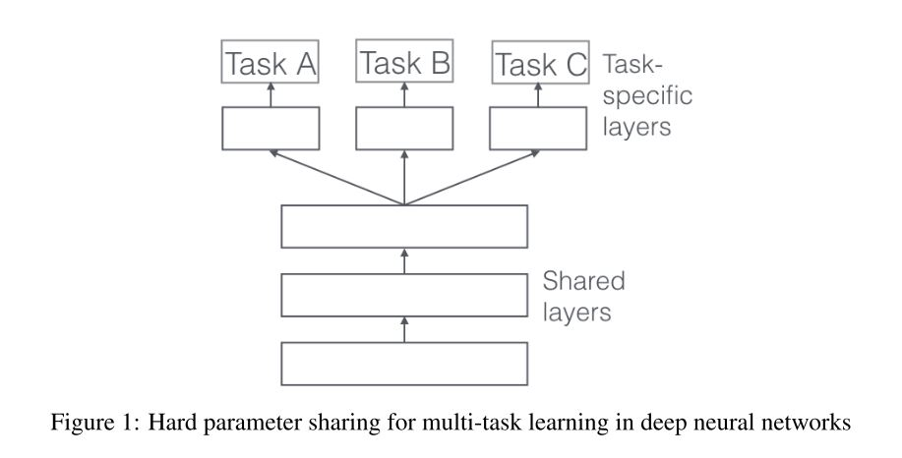
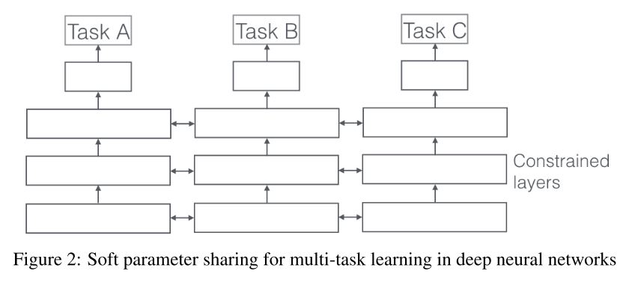
MTL methods for deep learning

Slide 5
Features of MTL
Implicit data augmentation: MLT ignores the data-dependent noise and generalizes well. As different tasks have different noise patterns, a model that learns two tasks simultaneously is able to learn a more general representation.
Attention focusing: If a task is very noisy or data is limited and high-dimensional, it can be difficult for a model to differentiate between relevant and irrelevant features. MTL can help the model focus its attention on those features that actually matter as other tasks will provide additional evidence for the relevance or irrelevance of those features.
Eavesdropping: Through MTL, we can allow the model to eavesdrop, i.e. learn G through task B, when it is harder for task A to learn certain feature G.
Representation bias: MTL biases the model to prefer representations that other tasks also prefer. This will also help the model to generalize to new tasks in the future as a hypothesis space that performs well for a sufficiently large number of training tasks will also perform well for learning novel tasks as long as they are from the same environment.
Regularization: MTL acts as a regularizer by introducing an inductive bias. As such, it reduces the risk of overfitting as well as the Rademacher complexity of the model, i.e. its ability to fit random noise.

Slide 6
MTL in non-neural model
Block Sparse Regularization: Many existing methods make some sparsity assumption with regard to the parameters of our models. [Argyriou and Pontil, 2007] assume that all models share a small set of features. In terms of our task parameter matrix A, this means that all but a few rows are 0, which corresponds to only a few features being used across all tasks.
As much as this block-sparse regularization is intuitively plausible, it is very dependent on the extent to which the features are shared across tasks. [Negahban and Wainwright, 2008] show that if features do not overlap by much, l₁/l_{q} regularization might actually be worse than element-wise l₁ regularization.
Learning task relationship: While the group-sparsity constraint forces our model to only consider a few features, these features are largely used across all tasks. All of the previous approaches thus assume that the tasks used in multi-task learning are closely related. However, each task might not be closely related to all of the available tasks. In those cases, sharing information with an unrelated task might actually hurt performance, a phenomenon known as negative transfer.
Rather than sparsity, here we would like to leverage prior knowledge indicating that some tasks are related while others are not. In this scenario, a constraint that enforces a clustering of tasks might be more appropriate.

Slide 7
Recent work on MTL for DL
As main task-
Deep relationship networks
Fully Adaptive Feature sharing
Cross-stich networks
Low supervision
A joint many-task model
Weighting losses with uncertainity
Tensor factorization for MTL
Sluice network
As auxiliary task-
Related
Adversarial
Focusing attention
Hints
Quantization smoothing
Predicting inputs
Representation learning

Slide 8
Further study guide
Topics for further study
Kernel methods, math behind learning task relationship
Weight losses with uncertainty
Deep relationship network, Fully Adaptive feature sharing, Sluice networks
Methods for auxiliary task
Papers to cover
A survey on multi task learning
Which tasks should be learned together in multi task learning?
Multi-task Learning Using Uncertainty to Weigh Losses for Scene Geometry and Semantics

